Slide 1


6G Wireless Communication:
Vision and Challenges
Group Members
JAS Sanjana D/ENG/22/0001/ET
GSS Senevirathne D/ENG/22/0002/ET
KASH Jayawardhana D/ENG/22/0029/ET

Slide 2

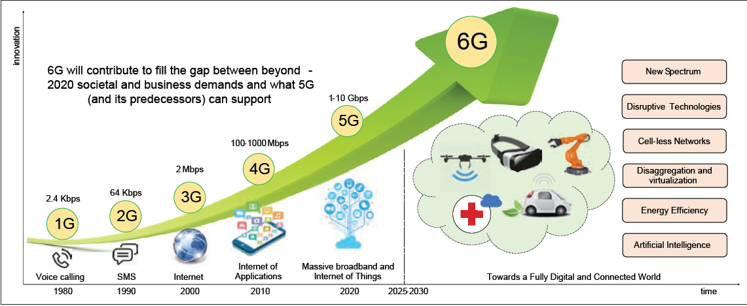
2

Slide 3
Evolution Of Wireless Communication
1G (1981): First-generation systems introduced analog FM-based cellular communication, primarily focused on voice transmission.
2G (1992): Marked the shift to digital communication, enabling SMS and improved voice quality using GSM standards.
3G (2001): Brought mobile internet access and supported video calling and basic multimedia services.
4G / LTE (2011): Enabled high-speed internet, HD video streaming, online gaming, and significantly reduced latency.
5G(2020): offering ultra-high speeds, ultra-low latency, and massive device connectivity. Multimedia streaming, Online gaming, High-definition (HD) video services, Smart homes and smart cities, Mobile commerce and digital payments
1

Slide 4


Introduction to 6G
6G is the next evolution in wireless communication.
It will offer:
Ultra-fast speeds and low latency
Smarter, energy-efficient systems
A fully connected world: connecting humans, vehicles, IoT, and robots
6G will enable new applications and immersive experiences, transforming how we connect.
3
3

Slide 5

3. Intelligent Networking
Utilizing AI and machine learning, 6G networks will adapt to user needs, optimizing performance and resource allocation in real-time.
The Vision for 6G
1. Ultra-Fast Connectivity : THz Spectrum
6G will use terahertz (THz) bands to deliver ultra-high data speeds for dense, data-heavy environments, enabling real-time applications.
4. Seamless Integration of Smart Devices
6G will connect billions of devices, from autonomous vehicles to wearables, enabling low-latency communication and seamless IoT functionality.
2. Ubiquitous Access
The vision includes global coverage, ensuring connectivity in rural and remote areas, bridging the digital divide and enhancing accessibility.
5. Sustainable & Energy-Efficient Systems
6G will prioritize energy efficiency, using wireless energy harvesting and smart grids to reduce the environmental impact of global networks.
4

Slide 6

Key Features in 6G
Extremely Large Bandwidth (THz Waves)
6G will utilize sub-THz and THz bands, enabling ultra-fast data transmission. While these high-frequency waves provide greater bandwidth, they come with limited range due to their sensitivity to obstacles.
Energy-Efficient Communication
6G aims to boost battery life and reduce power usage with ultra-low energy communication (as low as 1 picojoule/bit). This will be achieved through energy beams, smart relays, ambient energy harvesting, and more, turning networks into both data and power providers.
Artificial Intelligence (AI)
AI and Machine Learning (ML) will be central to 6G, enabling self-optimizing, context-aware networks. AI will help manage signal control, energy use, and service personalization, while making networks more efficient, adaptive, and capable of real-time decision-making.
High Security, Secrecy, and Privacy
6G will use quantum encryption, PHY-layer protection, and blockchain-based security to ensure secure, seamless communication across devices, industries, and environments.
With cell-less architectures, 3D networks, and distributed systems, 6G will ensure scalable and privacy-focused connectivity.
5

Slide 7

Requirements of 6G
For 6G to be successful, it needs new theories and perspectives:
1 Tbps data rate for seamless high-demand applications.
Ultra-low latency for targeting less than 1ms latency to support real-time interactions and immersive experiences.
High network reliability, ensuring 99.99999% reliability for missions and critical applications.
High spectrum efficiency, beyond the capabilities of 5G, utilizing frequencies like terahertz.
6

Slide 8

Applications of 6G
Next-Generation Connectivity
Enhanced Mobile Broadband Ultra-high-speed internet
HD streaming
Extended Reality
Immersive Augmented Reality , Virtual Reality , and Mixed Reality for education, medicine, and virtual tourism.
Holographic Communication Real-time 3D telepresence
Smart Mobility
Connected Autonomous Vehicles & Drones as base stations
Unmanned Aerial Vehicles (UAVs)
7

Slide 9
Smart Infrastructure & Industry
Digital Twins Real-time virtual models of cities/factories
Industry 5.0 Human-robot collaboration
Smart Grid 2.0 AI-based grid monitoring, automated distribution, and dynamic pricing
Future Healthcare
Internet of Medical Things (IoMT)
Connected wearables and implants for monitoring
Emerging Technologies
Blockchain for 6G
Secured, transparent data services
7

Slide 10

Use Cases for 6G
6G Use Cases refer to specific real-world scenarios where 6G technologies will be applied:
Massive URLLC (Ultra-Reliable Low-Latency Communication): Critical applications like smart factories, automated systems, and grid management that require ultra-reliable communication.
Human-Centric Services: Including services such as brain-computer interfaces, personalized healthcare, and smart living.
Haptics Communication: Providing remote tactile feedback for applications in virtual reality or telemedicine.
Unmanned Mobility: Enabling autonomous vehicles, drones, and flying cars to operate safely and efficiently.
Bio-IoT and Nano-IoT: Biological devices and nanodevices for advanced healthcare monitoring and environmental sensing.
8

Slide 11
Challenges in 6G Technology
Technical Challenges
Terahertz (THz) Communication
High water vapor absorption leads to molecular energy loss.
Free-space path loss in THz frequencies limits long-distance communication.
Only feasible for short-range communication unless improved with techniques like:
Ultra-massive MIMO, Reflect arrays , Distance-aware PHY design
Lack of mature THz transceivers and amplifiers.
Complex antenna design and miniaturization needs.
Spectrum Scarcity and Management
Demand for dynamic spectrum sharing and cognitive radio.
Radio spectrum will serve not only communication, but also location and environmental sensing
Energy Efficiency
6G requires low-energy devices and green network designs.
Large-scale deployment may increase carbon footprint if not managed.
9

Slide 12
Deployment & Infrastructure Challenges
Dense Network and Global Coverage
Need for ultra-dense small cells and integration with LEO satellites, UAVs, and terrestrial networks.
High cost and complexity of hybrid infrastructures.
Backward Compatibility
No full backward compatibility expected with 5G.
Transition may require dual-mode support and multi-RAT (Radio Access Technology) design.
Regulatory & Standardization Challenges
Policy and Spectrum Regulation
Global harmonization needed to prevent fragmented standards.
National policies must support secure, inclusive deployment.
International Collaboration
Avoiding geopolitical competition in setting standards.
Projects like the 6G Flagship Program and ITU’s IMT-2030 vision are essential.
10

Slide 13
Security & Privacy Challenges
Expanded Attack Surface
AI, IoT, and edge devices introduce new cyber vulnerabilities.
Decentralized trust models (e.g., blockchain, federated identity) needed.
AI Security & Model Integrity
Threats from adversarial ML, data poisoning, and model theft.
Quantum-Resilient Encryption
Current RSA/ECC encryption will be obsolete.
6G must adopt post-quantum cryptography (PQC).
Environmental Challenges
6G will dramatically increase network throughput and device density, leading to higher resource and power consumption.
Focus on low-carbon, recyclable infrastructure is critical.
11

Slide 14

6G’s Global Impact
6G will have a significant impact globally:
Economic Growth: Facilitating new business models in AI, autonomous systems, and smart cities.
Sustainability: Promoting environmentally friendly networks with energy-efficient communication and AI-based optimization.
Social Impact: Bringing connectivity to underserved areas and enabling global access to healthcare, education, and more.
12

Slide 15
Conclusion
6G is not just an upgrade to 5G, but a complete transformation in how we connect, communicate, and interact with the digital and physical world.
With terahertz communication, AI-native networks, integrated sensing, and space–terrestrial integration, 6G aims to enable futuristic applications like holographic telepresence, digital twins, and global real-time intelligence.
However, realizing this vision involves significant technical, economic, and regulatory challenges.
Global collaboration among governments, industries, and academia is already underway, with major testbeds and trials taking place worldwide.
The next few years (2025–2030) are critical in defining standards, developing key technologies, and ensuring that 6G is secure, inclusive, and sustainable.
13

Slide 16
References
[1] P. Kamble and A. N. Shaikh, “6G Wireless Networks: vision, requirements, applications and challenges,” in 6G Wireless Networks: Vision, Requirements, Applications and Challenges, Dec. 02, 2022. doi: 10.1109/icast55766.2022.10039549.
[2] M. H. Alsharif, A. H. Kelechi, M. A. Albreem, S. A. Chaudhry, M. S. Zia, and S. Kim, “Sixth generation (6G) wireless networks: vision, research activities, challenges and potential solutions,” Symmetry, vol. 12, no. 4, p. 676, Apr. 2020, doi: 10.3390/sym12040676.
[3] L. U. Khan et al., "6G Wireless Systems: A Vision, Architectural Elements, and Future Directions," IEEE Access, vol. 8, pp. 147029–147044, 2020, doi: 10.1109/ACCESS.2020.3015289. Summary: Analyzes architectural frameworks for IoE-driven 6G networks and discusses AI-based adaptive transceivers.
[4] M. Alsabah et al., "6G Wireless Communications Networks: A Comprehensive Survey," IEEE Access, vol. 9, pp. 148191–148243, 2021, doi: 10.1109/ACCESS.2021.3124812. Summary: Surveys enabling technologies (e.g., THz communication, AI/ML) and challenges for 6G, including scalability and security.
[5] M. Giordani, M. Polese, M. Mezzavilla, S. Rangan, and M. Zorzi, "Toward 6G Networks: Use Cases and Technologies," IEEE Communications Magazine, vol. 58, no. 3, pp. 55–61, Mar. 2020, doi: 10.1109/MCOM.001.1900411. Summary: Identifies 6G use cases (e.g., holographic communications) and technologies like visible light communication.
14

Slide 17
Thank You!

